Slide 1
AI and the mind
Exploring behaviour and IA

Slide 2

Demographic
We received survey responses from people around the world, covering a wide range of ages, educational backgrounds, and professions. The survey was divided into two main parts.
The first section focused on gathering personal and contextual information about each participant’s daily life and environment.
The second part explored their perception and use of AI.

Slide 3
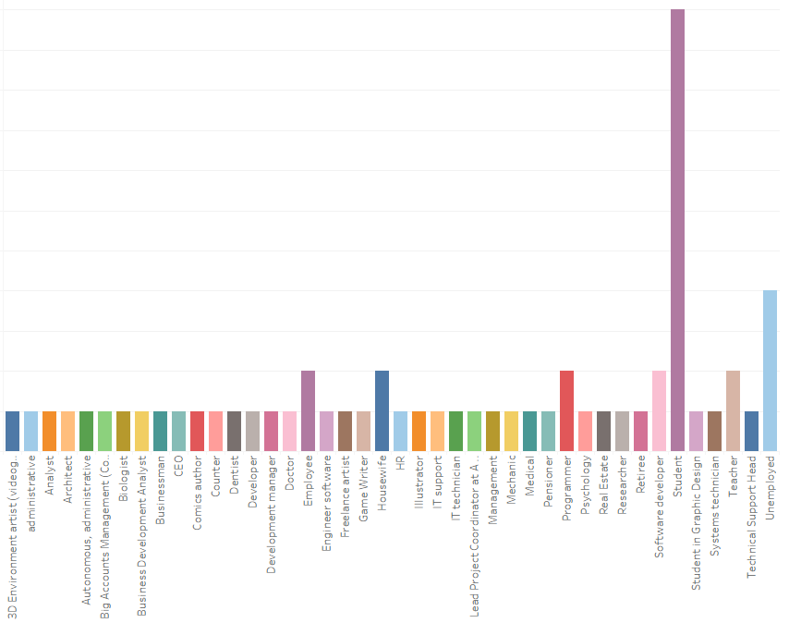
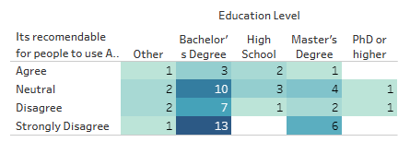

Slide 4
Hypothesis
People who use AI have a more lazy brain feeling → Failed
People who use AI tools more frequently are more likely to feel more confident in solving problems on their own without AI assistance. → Failed
Frequent users of AI tools are more likely to report being less stress → True with confidence of 98%

Slide 5
Ryff scale of psychological well-being
Dimension | Description
1. Self-Acceptance | Evaluating how one feels about oneself.
2. Positive Relations | Ability to maintain close interpersonal relationships.
3. Autonomy | Being independent and capable of resisting social pressures.
4. Environmental Mastery | Ability to manage life and the world around us.
5. Purpose in Life | Having goals and a sense of direction.
6. Personal Growth | Sense of ongoing development and openness to new experiences.

Slide 6
Question | Psychological Well-Being Dimension | Justification
How often do you use AI tools? | Autonomy / Environmental Mastery | Frequency of use reflects decision-making autonomy and the ability to manage available resources.
What do you primarily use AI tools for? | Purpose in Life / Personal Growth | The reason for use reflects goals, motivation, and personal development.
Do you feel more productive when using AI tools? | Environmental Mastery | Feeling productive suggests a sense of control and effectiveness in managing one’s environment.
Do you believe overuse of AI can negatively affect mental health or problem-solving skills? | Personal Growth / Autonomy | Questioning overuse implies self-reflection and awareness of one’s personal development.
Do you know someone that uses AI as a conversational partner? | Positive Relations with Others | Relates to how others use technology for interpersonal connection.
I feel more confident in solving problems on my own without AI assistance. | Autonomy / Environmental Mastery | Evaluates independence and confidence in one’s own abilities.
Using AI makes me feel mentally lazy. | Personal Growth / Autonomy | Suggests a perception of stagnation or technological dependence.
Relying on AI helps reduce my stress. | Self-Acceptance / Environmental Mastery | Stress reduction reflects emotional management and functional control over one’s surroundings.
AI tools make me second-guess my own knowledge or decisions. | Autonomy / Self-Acceptance | Reflects internal questioning and one’s relationship with personal judgment.
It is recommendable for people to use AI as a conversational partner. | Positive Relations with Others / Autonomy | Reflects opinion on AI in relational contexts and the freedom to choose how it’s used.

Slide 7
Liketr Notation
Scale Point | Label
1 | Strongly Disagree
2 | Disagree
3 | Neutral
4 | Agree
5 | Strongly Agree

Slide 8
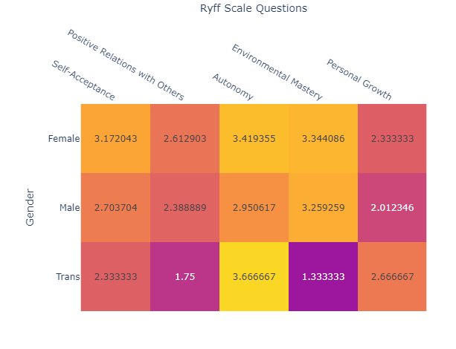

Slide 9
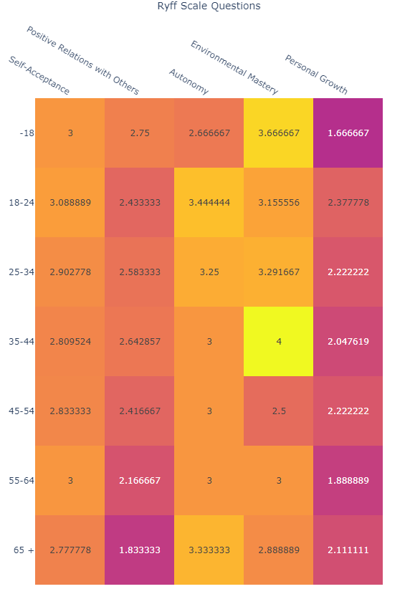

Slide 10
Conclusion
This study suggests that frequent use of AI tools may be quietly influencing how people feel about their own judgment and emotional independence. By focusing on well-being rather than just productivity, this approach offers a different way to think about AI's role in everyday life. It’s a small but important step toward understanding how we can use these tools without losing touch with our own instincts and confidence.

